Slide 1


Introducing:
The 2020-2021 South Carolina Junior Book Award Nominees

Slide 2
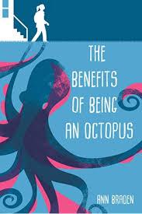
The benefits of being an octopus ann braden
Seventh-grader Zoey Albro focuses on caring for three younger siblings and avoiding rich classmates at school until her fascination with octopuses gets her on the debate team and she begins to speak out.

Slide 3
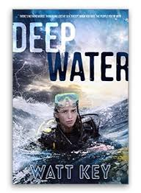
Deep Water
Watt key
When a dive off the coast of Alabama goes horribly wrong, twelve-year-old Julie and one of her father's scuba clients struggle to survive after reaching an abandoned oil rig.

Slide 4
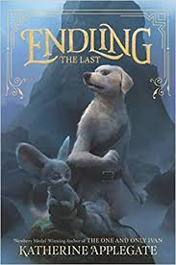
Endling : The Last
Katherine Applegate
Believed to possess mythical powers as the youngest member of her doglike dairne pack, Byx fears she has become the last of her species when her family is hunted to near-extinction, forcing her to band together with a ragtag group of animals and humans who help put into motion events that could trigger war throughout their kingdom.

Slide 5
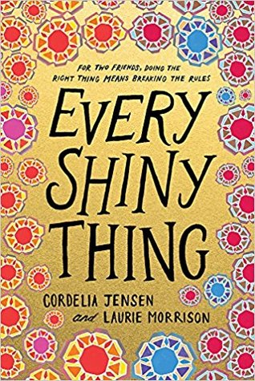
Every Shiny Thing
Cordelia Jensen &
Laurie Morrison
When Lauren begins stealing to raise money for autistic kids, like her brother, who don't have her family's resources, she convinces Sierra, a foster child, to help with the Robin Hood scheme, in a story told half in prose and half in verse.

Slide 6
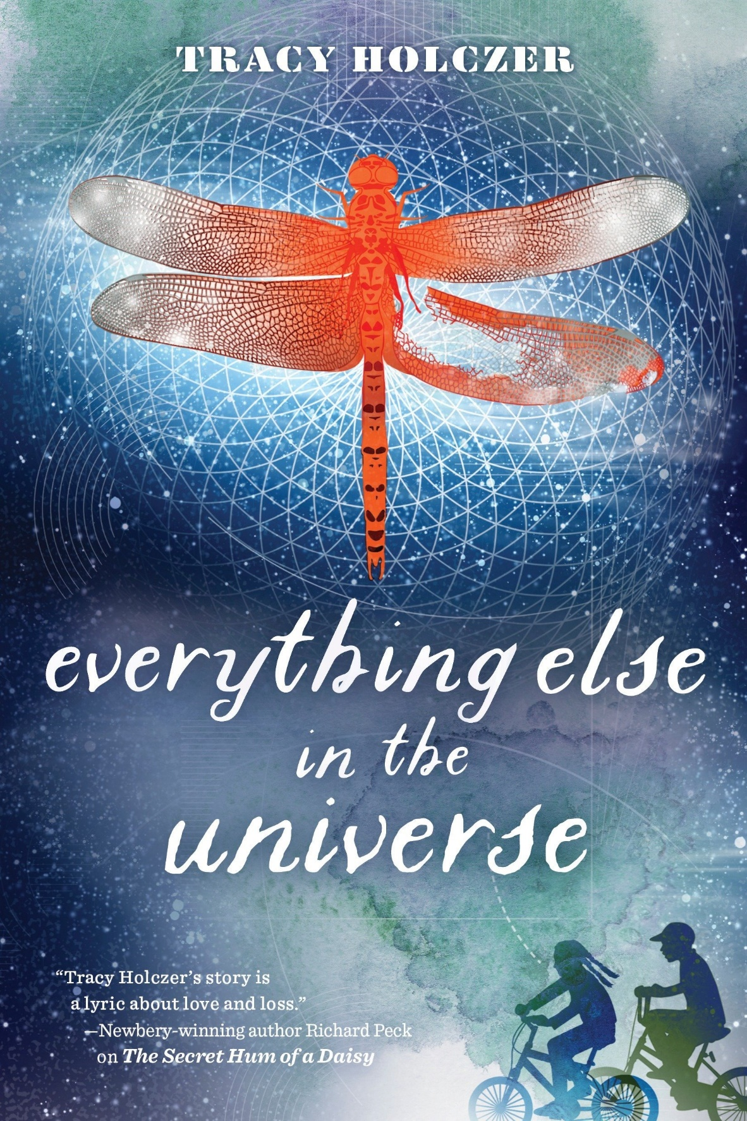
Everything else in the universe
Tracy Holczer
In 1971, twelve-year-old Lucy Rossi's dad returns from Vietnam after losing part of his arm, and her whole family must learn to adjust to a new dynamic, but Lucy's friend Milo unknowingly helps her navigate through this difficult time of fear and uncertainty to realize she is much tougher than she thought.

Slide 7
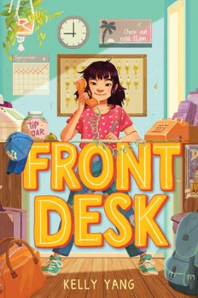
Front desk
Kelly yang
After emigrating from China, ten-year-old Mia Tang's parents take a job managing a rundown motel, despite the nasty owner, Mr. Yao, who exploits them, while she works the front desk and tries to cope with fitting in at her school.

Slide 8
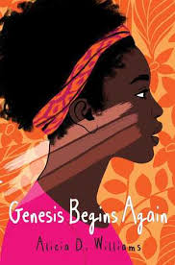
Genesis begins again
Alicia D. williams
Thirteen-year-old Genesis tries again and again to lighten her black skin, thinking it is the root of her family's troubles, before discovering reasons to love herself as is.

Slide 9
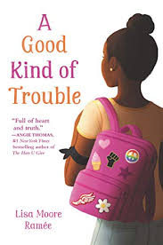
A Good Kind of Trouble
Lisa Moore Ramée
Strictly following the rules to pursue her junior-high ambitions, 12-year-old Shayla is forced to choose between her education and her identity when her sister joins the Black Lives Matter movement in the wake of a powerful protest.

Slide 10
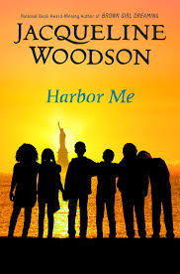
Harbor me
Jacqueline woodson
When six students are chosen to participate in a weekly talk with no adults allowed, they discover that when they're together, it's safe to share the hopes and fears they have to hide from the rest of the world.

Slide 11
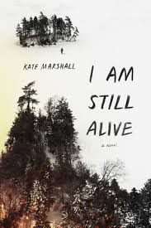
I am still alive kate marshall
Jess hadn't seen her survivalist, off-the-grid dad in over a decade. But after a car crash killed her mother and left her injured, she was forced to move to his cabin in the remote Canadian wilderness. Just as Jess was beginning to get to know him, a secret from his past paid them a visit, leaving her father dead and Jess stranded.

Slide 12
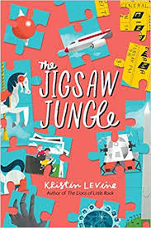
The jigsaw jungle
Kristin levine
Claudia Dalton, twelve, embarks on an unexpected treasure hunt that she hopes will bring her missing father home and heal whatever is wrong with her family. Told through notes, emails, audio and video transcripts, and more from Claudia's scrapbook.

Slide 13
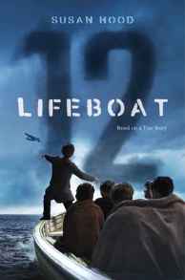
Lifeboat 12 susan hood
In 1940, a group of British children, their escorts, and some sailors struggle to survive in a lifeboat when the ship taking them to safety in Canada is torpedoed.

Slide 14

Marcus vega doesn’t speak Spanish
Pablo cartaya
After a fight at school leaves Marcus facing suspension, Marcus's mother takes him and his younger brother, who has Down syndrome, to Puerto Rico to visit relatives they do not remember or have never met, and while there Marcus starts searching for his father, who left their family ten years ago and is somewhere on the island.

Slide 15
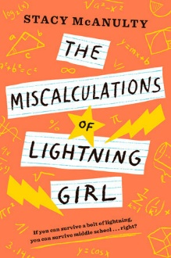
The miscalculations of lightning girl stacy mcanulty
Lucy Callahan was struck by lightning. She doesn't remember it, but it changed her life forever. The zap gave her genius-level math skills, and ever since, Lucy has been homeschooled. Now, at 12 years old, she's technically ready for college. She just has to pass 1 more test--middle school!

Slide 16
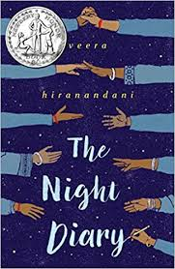
The Night diary veera hiranandani
Shy twelve-year-old Nisha, forced to flee her home with her Hindu family during the 1947 partition of India, tries to find her voice and make sense of the world falling apart around her by writing to her deceased Muslim mother in the pages of her diary.

Slide 17
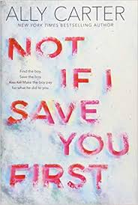
Not if I save you first ally carter
After six years of no word from her best friend, Logan, he shows up on the doorstep of the remote Alaskan cabin Maddie and her father live in with an assailant in pursuit.

Slide 18
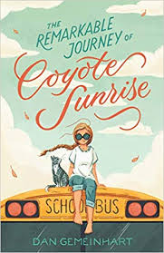
The remarkable journey of coyote sunrise dan gemeinhart
Twelve-year-old Coyote and her father rush to Poplin Springs, Washington, in their old school bus save a memory box buried in a park that will soon be demolished.

Slide 19
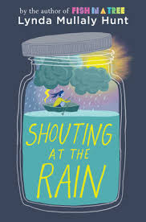
Shouting at the rain
Lynda mullaly hunt
Delsie loves tracking the weather, living with her grandmother, and the support of friends and neighbors, but misses having a "regular family," especially after her best friend outgrows her.

Slide 20
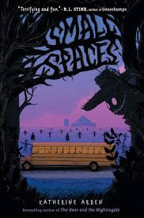
Small spaces
Katherine arden
After eleven-year-old Ollie's school bus mysteriously breaks down on a field trip, she has to take a trip through scary woods, and must use all of her wits to survive. She must stick to small spaces.

Slide 21
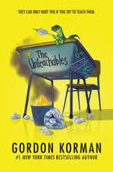
The unteachables
Gordon Korman
The Unteachables never thought they’d find a teacher who had a worse attitude than they did. And Mr. Kermit never thought he would actually care about teaching again. Over the course of a school year, though, room 117 will experience mayhem, destruction—and maybe even a shot at redemption.

Slide 22

Book covers and descriptions used with permission of Novelist K-8 Plus (EBSCO)
All media specialists should review all titles and add them to their
collections only if the titles meet the criteria established by District
Board Policy and Library Media Center Policy & Procedure
guidelines. We recommend that others interested in purchasing these
titles read reviews and scan materials to determine the
appropriateness for their intended readers.

