Slide 1


SC Young adult book award nominees
2020-2021

Slide 2

After the Shot Drops by Randy Ribay
Told from alternating perspectives, Bunny takes a basketball scholarship to an elite private school to help his family, leaving behind Nasir, his best friend, in their tough Philadelphia neighborhood.

Slide 3
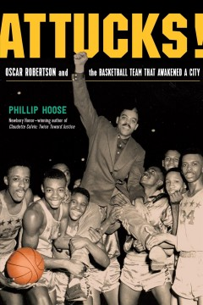
Attucks!: Oscar Robertson and the Basketball Team That Awakened a City by Phillip Hoose
Traces the inspirational story of the Crispus Attucks High School Tigers basketball team and how they broke the color barrier in segregated 1950s Indiana to become state champions.

Slide 4
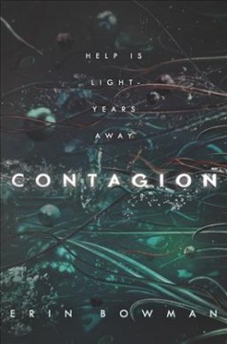
Contagion by Erin Bowman
Responding to a distress call on the distant planet of Achlys, Thea Sadik and her search-and-rescue crew are confronted by a zombie-like outbreak that forces them to uncover a monstrous enemy.

Slide 5
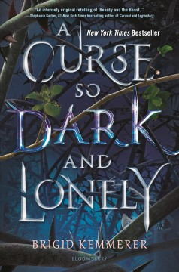
A Curse So Dark and Lonely by Brigid Kemmerer
Eighteen for the three hundred twenty-seventh time, Prince Rhen despairs of breaking the curse that turns him into a beast at the end of each day until feisty Harper enters his life.

Slide 6

The Hazel Wood by Melissa Albert
Seventeen-year-old Alice and her mother have spent most of Alice’s life on the road, always a step ahead of the uncanny bad luck biting at their heels. But when Alice’s grandmother, the reclusive author of a cult-classic book of pitch-dark fairy tales, dies alone on her estate, the Hazel Wood, Alice learns how bad her luck can really get: Her mother is stolen away—by a figure who claims to come from the Hinterland, the cruel
supernatural world where her grandmother's stories are set.

Slide 7

Here to Stay by Sara Farizan
When a cyberbully sends the entire high school a picture of basketball hero Bijan Majidi, photo-shopped to look like a terrorist, the school administration promises to find and punish the culprit, but Bijan just wants to pretend the incident never happened and move on.

Slide 8
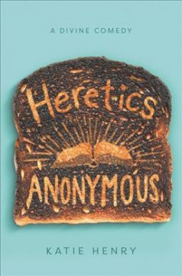
Heretics Anonymous by Katie Henry
When nonbeliever Michael transfers to a Catholic school in eleventh grade, he quickly connects with a secret support group intent on exposing the school's hypocrisies one stunt at a time.

Slide 9

Hey, Kiddo by Jarrett J. Krosoczka
A powerful graphic memoir by the award-winning author of Lunch Lady and the Cyborg Substitute traces the author's unconventional coming of age with a drug-addict mother, an absent father and two lovingly opinionated grandparents.

Slide 10

I Have the Right to: A High School Survivor’s Story of Sexual Assault, Justice, and Hope by Chessy Prout
A young survivor tells her searing, visceral story of sexual assault, justice, and healing in this gut-wrenching memoir.

Slide 11

The Silence between Us by Alison Gervais
Deaf teen Maya Harris must navigate a new life--and love--in this own-voices novel from award-winning author Alison Gervais. When Maya is forced to attended a hearing school, she sets out to prove that her lack of hearing won’t stop her from chasing her dreams.

Slide 12
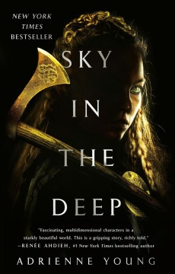
Sky in the Deep by Adrienne Young
Raised to be a warrior, seventeen-year-old Eelyn fights alongside her Aska clansmen in an ancient rivalry against the Riki clan, but when faced with her brother's betrayal, and driven by a growing love for her brother's friend Fiske, she attempts to unite the two clans.

Slide 13

Skyward by Brandon Sanderson
When a long-term attack against her world by the alien Krell escalates, Spensa's dream of becoming a pilot may come true, despite her deceased father being labeled a deserter.

Slide 14
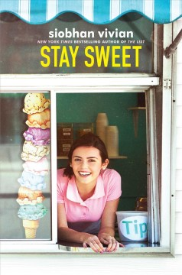
Stay Sweet by Siobhan Vivian
Seventeen-year-old Amelia has looked forward to her last summer before college working at the Meade Creamery, but when the owner of the local landmark passes away her nephew has big changes in mind.

Slide 15

Stronger, Fast, and More Beautiful by Arwen Elys Dayton
Six interconnected stories that ask how far we will go to remake ourselves into the perfect human specimens, and how hard that will push the definition of human.

Slide 16
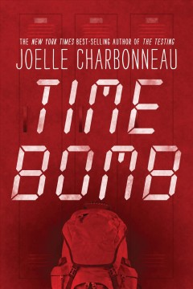
Time Bomb by Joelle Charbonneau
Six students are trapped in their school after a bomb goes off, and must fight to survive while discovering who among them is the bomber.

Slide 17
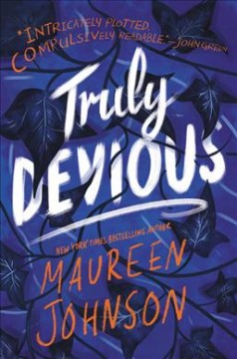
Truly, Devious by Maureen Johnson
Ellingham Academy is a famous private school in Vermont for the brightest thinkers, inventors, and artists. It was founded by Albert Ellingham, an early twentieth century tycoon, who wanted to make a wonderful place full of riddles, twisting pathways, and gardens. “A place,” he said, “where learning is a game.”

Slide 18

A Very Large Expanse of Sea by Tahereh Mafi
A year after 9/11, Muslim teenager Shirin has completely withdrawn from social life, until she meets Ocean James in her biology class and is tempted to actually let her guard down.

Slide 19

The Waning Age by S. E. Grove
A tale set in an alternate-world San Francisco where people gradually lose their emotions as they become adults finds a highly skilled fighter teen confronting the world's most powerful company when she retains a fierce love for her little brother.

Slide 20

We’ll Fly Away by Bryan Bliss
Best friends Toby and Luke are bound together by the goal of leaving their hometown and family problems behind, but a series of choices each makes during their senior year threatens their bright future plans.

Slide 21

What You Hide by Natalie D. Richards
A new pulse-pounding romantic thriller from the author of We All Fall Down and Six Months Later. Spencer volunteers at the library. Sure, it's community service, but he likes his work. Especially if it means getting to see Mallory. Mallory spends a lot of time keeping her head down. When you're sixteen and homeless, nothing matters more than being anonymous. But Spencer's charm makes her want to be noticed. But after a tragic death at the library, ghostly voices and messages begin to appear. Spencer and Mallory know a homeless teenager makes an easy target, and their safe haven may not be as safe as they thought.

Slide 22
All media specialists should review all titles and add them to their
collections only if the titles meet the criteria established by District
Board Policy and Library Media Center Policy & Procedure
guidelines. We recommend that others interested in purchasing these
titles read reviews and scan materials to determine the
appropriateness for their intended readers.

Slide 23
Novelist Plus (a database at www.scdiscus.org)
Thank you to the 2019-20 SC Young Adult Book Award Committee:
Toni Anderson (Vice Chair)
Faith Barber
Marti Brown
Kathy Carroll
Lauren Cook
Caitlin Creagan
Samantha Finkenberg
Michelle Greene (Chair)
Allison Hall
Susan Henley
Kim Hudson
Mike LeRoy
Laura Lundeen
Leslie McDuffie
Colette Schmidt
Roxanne Spray
Donna Taylor
Rhonda Tiwari
Melissa Tucker
Laura Ward
Anna Webb
Book summaries and images courtesy of:

