Slide 1
South Carolina
Picture Book Award Nominees
2019- 2020

Slide 2
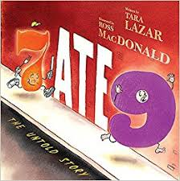
Number 6 shows up at Private I’s office with a mystery to solve. Word on the street is that 7 ate 9! And now 6 is scared that they may be next. Private I has a big mystery to solve and things are just not adding up.
AD530L

Slide 3
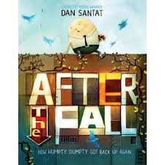
With a little help, Humpty Dumpty survived a terrible fall off the wall. But just like most people would be, he was scared to get back up again. Humpty Dumpty has to overcome his fears to get back to doing what he loves most, watching and being close to the birds.
AD550L

Slide 4
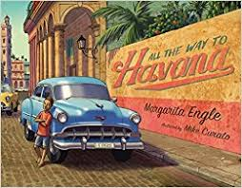
This is the story of a little boy, his parents and other family members driving into the city of Havana for a family celebration. The author uses prose as well as onomatopoeia to help make the story an event of the sights and sounds of historic Cuba.
AD890L

Slide 5
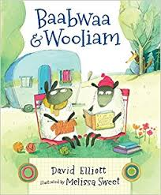
Baabwaa and Wooliam live a nice, quiet life full of knitting and reading. This all changes when they decide to go on an adventure and find a third sheep … one with a tattered wool coat and long, decaying teeth. Is he really a sheep at all? Wooliam recognizes their new friend from his readings, and the pair of sheep decide to befriend the newcomer, help him learn to read, and clean up his dental hygiene.
AD530L

Slide 6
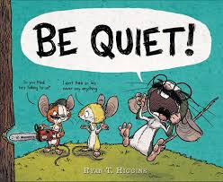
Rupert the mouse always has big plans. In this story by Ryan T. Higgins, Rupert is on a mission to create his own wordless picture book. However, he also has two very talkative friends who just won’t stop talking! Do they even understand what a wordless book means? While his two friends try to help him create the book he wants, Rupert realizes that he is doing most of the talking! His friends kindly remind him that his book should not have any words. Poor Rupert was just trying to make his own book! Will his friends ever learn what wordless means? A truly laugh out loud story with an even funnier ending.
AD510L

Slide 7
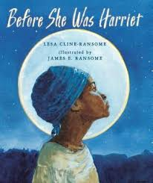
Before She was Harriet, by Lesa Cline-Ransome is a book that takes you on a journey through the life of Harriet Tubman. Told in reverse order, it starts with her life as an older Harriet, being a suffragist and voicing her opinion loud and angry to stand up against injustice. Harriet’s life is described in many ways, including Union spy, nurse, Aunt, Moses, Minty, and Arminta. The book ends with bringing the reader back to Harriet, the woman who dreamed of living long enough to one day be free.
NP

Slide 8
This charming rhyming book tells the story of Billy, who needs to be rescued from an enormous pile of green goo. There are all sorts of people who come to his rescue, only to be trapped themselves. The illustrations are hilarious and include witty quips as the story unfolds.
AD540L

Slide 9
Lizzie, the busiest bee in Hivetown, tries to do everything and succeed because she wants to meet the Queen Bee. Lizzie is so over scheduled and so obsessed with trying to do it all that she winds up going to sleep during the school spelling bee and missing out on meeting the Queen. It is only when she finally visits the garden with her friend Lazy Daizy and meets a most relaxed Queen that she learns to stop and smell the roses.
AD570L

Slide 10
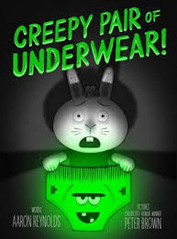
Jasper Rabbit is super excited! He has grown up so much that he can now pick out his own underwear. He and his mom go shopping and Jasper picks out the coolest underwear-“Creepy Underwear.” Jasper can’t wait to wear his new underwear! That is, until he turns off the lights and the underwear glow a ghoulish, greenish color. Jasper thinks the underwear is a little too creepy, so he tries to dispose of it. But the underwear always returns. In desperation Jasper buries the underwear and he is so relieved to finally be rid of that creepy underwear . . . But then he comes to the realization that creepy underwear make great night-lights!
AD470L

Slide 11
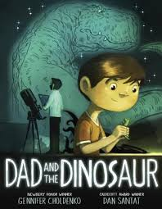
Nicholas wishes he could be brave just like his dad, but he needs help from his toy dinosaur. Carrying a toy dinosaur in his pocket helps Nicholas face his fear of the dark, outside his door, giant bugs, and the underside of manhole cover. One day at soccer, his dinosaur goes missing. He is afraid to tell his mom about his problem so he secretly tells his dad. Nicholas and Dad set out to search for the lost dinosaur to regain Nicholas’s bravery.
AD560L

Slide 12
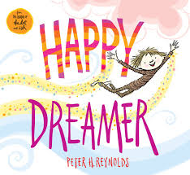
Peter Reynolds, master of inspirational picture books, delves into all the reasons why being a dreamer is freeing for the mind and spirit. The main character, whose gender is undetermined, demonstrates resilience, a critical life skill for students to acquire. The book also includes double fold-out pages of different types of dreamers, so that kids can find themselves among the many examples.
AD490L

Slide 13
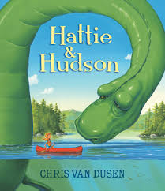
Hattie McFadden is a born explorer. Every morning she grabs her life jacket and paddles out in her canoe to discover something new on the lake, singing a little song on her way. When her singing draws up from the depths a huge mysterious beast, everyone in town is terrified — except Hattie, who looks into the creature’s friendly, curious eyes and knows that this is no monster. So Hattie sneaks out at night to see the giant — whom she names Hudson — and the two become friends. But how can she make the frightened, hostile townspeople see that Hudson isn’t scary or dangerous at all? Chris Van Dusen brings his colorful, perspective-bending artwork to this satisfying new story about acceptance, friendship, and sticking up for those who are different.
AD640L

Slide 14
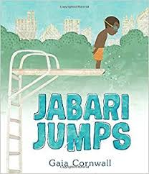
Jabari has finished his swimming classes. He is an excellent swimmer, but now he wants to master another aquatic feat, jumping off the high dive at the pool. Does he make the leap or does he wait?
AD490L

Slide 15
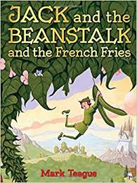
When Jack trades the family cow for a handful of magic beans, he gets more beans than he ever expected or wanted. A massive crop of beans grows causing Jack to eat bean porridge for breakfast, bean salad for lunch, and bean chowder for dinner! He soon grows tired of eating just beans and decides to chop down his magic beanstalk, when he meets a grumpy giant, who is just as sick and tired of beans as he is. Together, Jack and the giant cook up a plan to plant a vegetable garden full of tomatoes, corn, carrots, and russet potatoes which should allow for a little more variety to the menu. “A deliciously zany retelling of Jack and the Beanstalk from author Mark Teague ends with one happy boy, a satisfied giant, and a large plate of french fries.”
560L

Slide 16
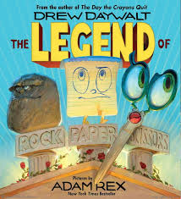
A stone-faced warrior named Rock searches through backyard environs for a worthy opponent, battling a clothespin and an apricot and emerging victorious. Meanwhile Paper, on his home office turf, fights with a printer and a bag of snacks -- and ends up the winner. While that is going on, Scissors duels with tape and chicken nuggets in her search for an even match, conquering both handily. Eventually all three implements meet up with each other. The ensuing battles ensure they have all met their matches -- and become best friends -- while creating a game that school children still play.
AD670L

Slide 17
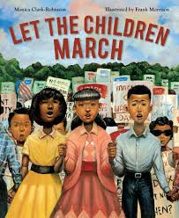
Noticing the limitations that surround her in segregated Birmingham, Alabama, a young girl attends a meeting in which she hears Dr. King urge his followers to march. Her parents voice concerns about the repercussions of participating in the march, and our main character and her brother decide that they should march instead of their parents. Events parallel the 1963 Children’s March in Birmingham, Alabama. By the end of the book, the main character sees that changes are happening, and believes that she has made a difference.
650L

Slide 18
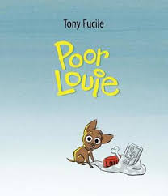
Louie is a dog who was living a perfectly perfect life until… they started to appear. Although they were only small annoyances these changes made Louie feel uncomfortable. Then Louie's mom's stomach started getting bigger. He was fine until one day, it (whatever was inside mom’s stomach) kicked him! What will happen to poor Louie?
AD480L

Slide 19
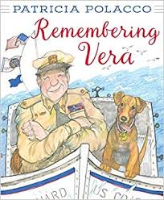
In 1962 a stray dog was found under a pile of boxes in a Coast Guard warehouse in what used to be called Government Island, the Coast Guard Base in San Francisco Bay, when a seaman named Dave Bunch was mopping the floor. It was love at first sight. At first the men decided to hide the pup from the Commander, thinking she wouldn't be allowed. But soon enough all of the men in the barracks fell hard for the little dog. Then one day when high waves challenged another vessel at sea, it was Vera's fierce determination and natural swimming ability that brought the life preserver and safety line to the sinking boat. Vera became a hero and the beloved pet and mascot of the San Francisco Coast Guard.
AD780L

Slide 20
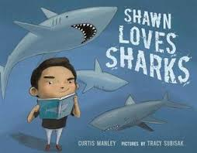
Shawn loves sharks! He loves to read about sharks and he loves to act like a shark. When his teacher assigns each student in class an animal to research, he excitedly calls out that he “gets the shark!” Unfortunately, he is assigned the leopard seal while a classmate, Stacy, is assigned his favorite animal.
AD490L

Slide 21
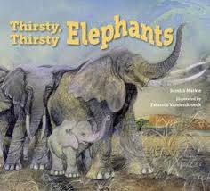
During a drought in Tanzania, Grandma Elephant leads her family and herd in a search for water based on her memories of past watering holes.
AD610L

