Slide 1

Introducing:
The 2019-20 South Carolina Junior Book Award Nominees

Slide 2

All’s Faire in Middle School by Victoria Jamieson
Homeschooled by Renaissance Faire enthusiasts, eleven-year-old Imogene has a hard time filling in when her wish to enroll in public school is granted.

Slide 3

Beyond the Bright Sea
by Lauren Wolk
Crow washed ashore on a tiny Massachusetts island as a baby. A fire on another uninhabited island that once housed a leper colony raises her curiosity about her origins, which leads to fearful danger.

Slide 4

Epic Fail of arturo zamora
by Pablo Cartaya
Tells the story of Arturo, who is looking forward to a relaxing summer until Carmen, a cute and funny girl moves into his apartment complex and while he deals with his stomach turning into a deep fryer over a girl, a smarmy land developer rolls into town and threatens to change it.

Slide 5

The First Rule of Punk
by Celia C. Perez
Twelve-year-old Maria Luisa O'Neill-Morales (who really prefers to be called Malu) reluctantly moves with her Mexican-American mother to Chicago and starts seventh grade with a bang--violating the dress code with her punk rock aesthetic and spurning the middle school's most popular girl in favor of starting a band with a group of like-minded weirdos.

Slide 6

Fred Korematsu Speaks Up
by Laura Atkins and Stan Yogi
When the U.S. Government forced all people of Japanese ancestry into prison camps during WWII, Fred Korematsu refused to go. This is the story of his fight against discrimination, and his quest to make the United States a fairer place for all Americans.

Slide 7

Genevieve’s War
by Patricia Reilly Giff
In August 1939 Genevieve makes an impulsive decision not to get on train to take her to a boat back to New York and must spend the duration of World War II with her grandmother in a small village in Alsace, France, where she becomes involved with the French resistance.

Slide 8

Greetings From Witness Protection
by Jake Burt
Thirteen-year-old Nikki Demere is an orphan and a kleptomaniac, making her the perfect girl to portray the Trevors' daughter in witness protection, but she soon learns that the biggest threat to her new family's security comes from her own past.

Slide 9

Halfway Normal
by Barbara Dee
Twelve-year-old cancer survivor Norah struggles to fit in at middle school after two years of treatment, but she finds her voice with the help of new friend Griffin, who shares her love of mythology.

Slide 10

Hear The Wolves
by Victoria Scott
Sloan Riley is a skilled hunter, but since her mother left, and she lost hearing in one ear, she has clung to her father and older sister, so waking up and discovering they have left her for a few days terrifies her--but when an autumn blizzard threatens to bury her small Alaskan town, and the wolves begin to hunt, she must find her courage if she is to get herself and the few remaining citizens to safety beyond the forest.

Slide 11

In Some Other Life
by Jessica Brody
Kennedy chose to pursue the boy of her dreams rather than attend an elite private school, but as their romance ends she gets a glimpse of the not-so-perfect life she might have had.

Slide 12
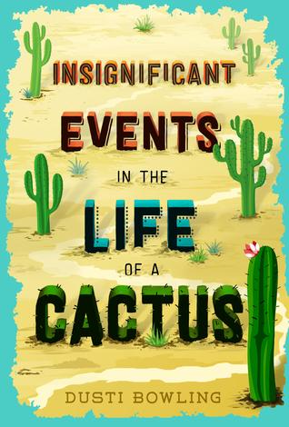
Insignificant Events in the Life of a Cactus
by Dusti Bowling
Aven Green loves to tell people that she lost her arms in an alligator wrestling match, or a wildfire in Tanzania, but the truth is she was born without them. And when her parents take a job running Stagecoach Pass, a rundown western theme park in Arizona, Aven moves with them across the country knowing that she'll have to answer the question over and over again.

Slide 13

Last Day on Mars: Chronicle of the Dark Star
by Kevin Emerson
While waiting to leave Mars before it burns up just like the Earth before it, Liam and his friend Phoebe discover some facts about time and space and realize that the human race is just one of the races trying to survive in space.

Slide 14
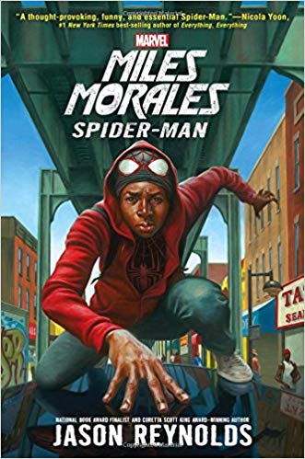
Miles Morales, Spider-Man
by Jason Reynolds
Brooklyn Visions Academy student Miles Morales may not always want to be a super hero, but he must come to terms with his identity--and deal with a villainous teacher--as the new Spider Man.

Slide 15

Nemesis
by Brendan Reichs
As the Anvil, an enormous asteroid, threatens to end all life on Earth, sixteen-year-old Min begins to uncover a lifetime of lies, a sinister conspiracy involving all students in her sophomore class in Fire Lake, Idaho.

Slide 16

Restart
by Gordon Korman
Chase does not remember falling off the roof, in fact he does not remember anything about himself, and when he gets back to middle school he begins to learn who he was through the reactions of the other kids--trouble is, he really is not sure he likes the Chase that is being revealed, but can he take the opportunity amnesia has provided and restart his life?

Slide 17

Saving Marty
by Paul Griffin
When Lorenzo adopts a runt piglet destined for auction, an unexpected, life-changing friendship forms.

Slide 18

The Secret Sheriff of Sixth Grade
by Jordan Sonnenblick
Disheartened that he’s unable to protect his mother from her latest abusive boyfriend, Maverick decides to model his sixth-grade persona on his favorite superheroes (Spider-Man and Captain America) by doing good deeds and protecting smaller, weaker kids at school.

Slide 19
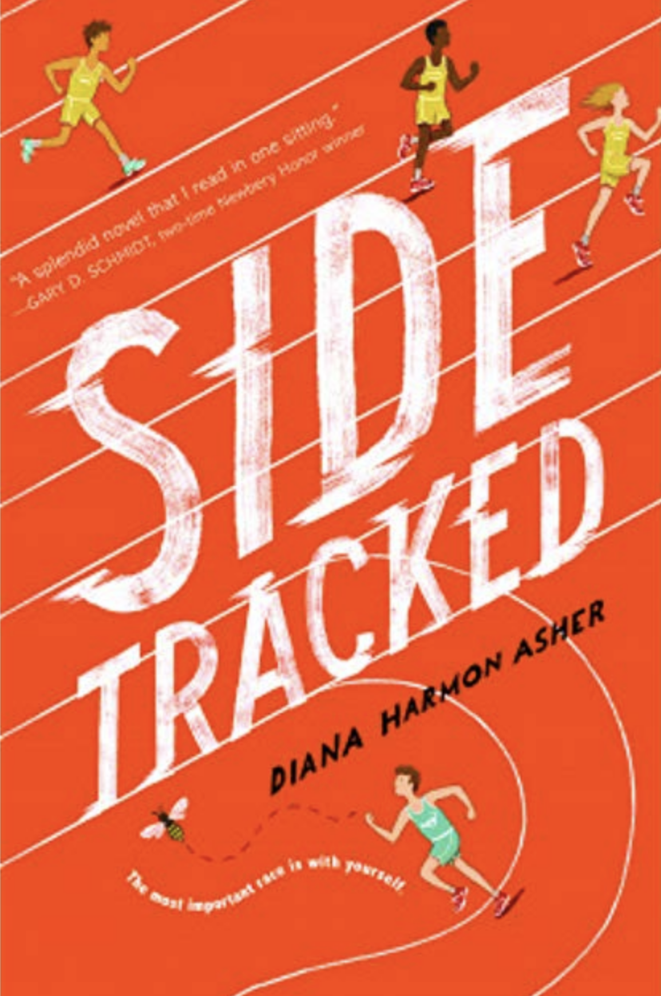
Sidetracked
by Diana Harmon Asher
Seventh-grader Joseph Friedman is friendless and puny, with ADD to boot. He spends most of his time avoiding the class bully and hiding out in the Resource Room. But the Resource Room teacher encourages (i.e., practically forces) him to join the school cross country team, and he meets Heather, a new student who's tough and athletic and refuses to be pushed around by anybody.

Slide 20

The Truth As Told by Mason Buttle
by Leslie Connor
Under a cloud of suspicion after the death of his best friend, a boy with a “trifecta of troubles” continues as best he can. Mason is again suspect.Mason is large for his age, highly dyslexic, abnormally sweaty, and the regular target of bullying neighbor boys. He feels his emotions as colors—green for stress, shades of pink for happiness. There hasn’t been much pink in Mason’s life in the 16 months since Benny’s accidental death, but now there’s a new friend, tiny Calvin Chumsky, and the bullying neighbor’s dog, Moonie, who prefers Mason.

Slide 21

Wild Bird
by Wendell Van Draanen
When her behavior escalates out of control, fourteen-year-old Wren is taken away to a wilderness therapy camp where she is forced to develop new skills, including the courage to ask for help.

