Slide 1
South Carolina Children’s Book Award Nominees 2019-20

Slide 2

Amina’s Voice
Hena Khan
"A Pakistani-American Muslim girl struggles to stay true to her family's vibrant culture while simultaneously blending in at school after tragedy strikes her community.” Provided by publisher

Slide 3

Bolivar
Sean Rubin
“What would you do if your neighbor was a dinosaur? Going extinct isn't for everyone. Sybil knows that there is something off about her next door neighbor, but she can't seem to get anyone to believe her. Everyone is so busy going about their days in the busy streets of New York City that they don't notice Bolivar. They don't notice his odd height, his tiny arms, or his long tail. No one but Sybil sees that Bolivar is a dinosaur. When an unlikely parking ticket pulls Bolivar into an adventure from City Hall to New York's Natural History Museum, he must finally make a choice: continue to live unnoticed, or let the city see who he really is.” From the publisher

Slide 4
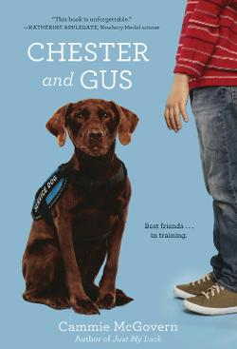
Chester and Gus
Cammie McGovern
Chester hopes to follow in his mother's paw prints and become a service dog, but when a family with an autistic son adopts him, it's not exactly what Chester imagined, but he'll do whatever he can to prove he's the right dog for the job.

Slide 5

Confessions from a Principal’s Kid
Robin Mellom
During the school day, fifth-grader Allie West is an outsider. Everyone knows the principal's kid might tattle to her mom! But after school, Allie is an insider. She's friendly with the janitor, knows the shortest routes around the building, and hangs out with the Afters, a group of misfits whose parents are teachers at their school. Although Allie secretly loves her insider life, she's sick of being an outsider--so she vows to join the Pentagon, the popular math team led by her ex-best friend. But can Allie change her status without betraying where she really belongs?

Slide 6
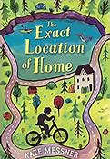
The Exact Location of Home
Kate Messner
Believing his long-absent father is missing and leaving clues behind through geocaching, Zig, thirteen, relies on his love of electronics, a garage sale GPS unit, and his best friend, Gianna, to search for answers.

Slide 7
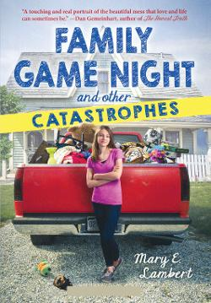
Family Game Night and Other
Catastrophes
Mary E. Lambert
Seventh-grader Annabelle's mother is a hoarder, and their whole house is full of canned goods, broken toys, fabric, and old newspapers--but when a pile of newspapers (organized by weather reports) falls on Annabelle's younger sister Leslie and their mother is more concerned about the newspapers, it sets off a chain of events that brings their fix-it-all grandmother in and Annabelle realizes that if there is any hope for change she can not isolate herself and keep her family's problems secret.

Slide 8

Grand Canyon
Jason Chin
Rivers wind through earth, cutting down and eroding the soil for millions of years, creating a cavity in the ground 277 miles long, 18 miles wide, and more than a mile deep known as the Grand Canyon.
Home to an astonishing variety of plants and animals that have lived and evolved within its walls for millennia, the Grand Canyon is much more than just a hole in the ground. Follow a father and daughter as they make their way through the cavernous wonder, discovering life both present and past.

Slide 9

Granted
John David Anderson
Everyone who wishes upon a star, or a candle, or a penny thrown into a fountain knows that you're not allowed to tell anyone what you've wished for. But even so, there is someone out there who hears it. In a magical land called the Haven lives a young fairy named Ophelia Delphinium Fidgets. Ophela is no ordinary fairy--she is a Granter: one of the select fairies whose job it is to venture out into the world and grant the wishes of unsuspecting humans every day. It's the work of the Granters that generates the magic that allows the fairies to do what they do, and to keep the Haven hidden and safe. But with worldwide magic levels at an all-time low, this is not as easy as it sounds. On a typical day, only a small fraction of the millions of potential wishes gets granted. Today, however, is anything but typical. Because today, Ophelia is going to get her very first wish-granting assignment. And she's about to discover that figuring out how to truly give someone what they want takes much more than a handful of fairy dust.

Slide 10

Joplin, Wishing
Diane Stanley
While cleaning out her reclusive grandfather's house, Joplin discovers pieces of a broken platter in a cookie tin. After having the platter repaired, Joplin wishes that she could both find a friend at school, and befriend the girl pictured in the platter. The next day, Joplin befriends a boy named Barrett, and also notices a girl outside her apartment. A girl who looks remarkably like the girl in the platter...The girl introduces herself as Sofie, and she has a terrible secret. Cursed to grant wishes for the owner of the platter for all of time, she has been trapped for centuries. Joplin and Barrett vow to help her, but freeing Sofie is more complicated than they could have imagined, and the three friends end up against a sinister foe who could put them all in terrible danger.

Slide 11

Let’s Pretend We Never Met
Melissa Walker
If it were up to Mattie Markham, there would be a law that said your family wasn't allowed to move in the middle of the school year. After all, sixth grade is hard enough without wondering if you'll be able to make new friends or worrying that the kids in Pennsylvania won't like your North Carolina accent. But when Mattie meets her next-door neighbor and classmate, she begins to think maybe she was silly to fear being the 'new girl.' Agnes is like no one Mattie has ever met--she's curious, hilarious, smart, and makes up the best games. If winter break is anything to go by, the rest of the school year should be a breeze. Only it isn't, because when vacation ends and school starts, Mattie realizes something: At school Agnes is known as the weird girl who no one likes. All Mattie wants is to fit in (okay, and maybe be a little popular too), but is that worth ending her friendship with Agnes?

Slide 12

Little Leaders: Bold Women in Black History
Vashti Harrison
An important book for all ages, Little Leaders educates and inspires as it relates true stories of forty trailblazing black women in American history. Illuminating text paired with irresistible illustrations bring to life both iconic and lesser-known female figures of Black history such as abolitionist Sojourner Truth, pilot Bessie Coleman, chemist Alice Ball, politician Shirley Chisholm, mathematician Katherine Johnson, poet Maya Angelou, and filmmaker Julie Dash.

Slide 13

Mango Delight
Fracaswell Hyman
When seventh-grader Mango Delight Fuller accidentally breaks her BFF Brooklyn's new cell phone, her life falls apart. She loses her friends and her spot on the track team, and even costs her father his job as a chef. But Brooklyn's planned revenge--sneakily signing up Mango to audition for the school musical--backfires when Mango not only wins the lead role, but becomes a YouTube sensation and attracts the attention of the school's queen bee, Hailey Jo ... Soon Mango finds herself forced to make tough choices about the kind of friend she wants to have ... and, just as important, the kind of friend she wants to be.

Slide 14

Real Friends
Shannon Hale
Following little Shannon's life from kindergarten through fifth grade, Real Friends captures the emotional roller coaster ride of friendship, from navigating the tricky waters of cliques and bullies to her never-ending struggle to stay in "The Group." Shannon's honest and heartfelt story reminds us of how hard it was to learn what real friends are--and why finding them is worth the journey.

Slide 15

Sergeant Reckless: The True Story of the Little Horse Who Became a Hero
Patricia McCormick
The inspiring true story of Reckless, the brave little horse who became a Marine.
When a group of US Marines fighting in the Korean War found a bedraggled mare, they wondered if she could be trained to as a packhorse. They had no idea that the skinny, underfed horse had one of the biggest and bravest hearts they'd ever known. And one of the biggest appetites!
Soon Reckless showed herself more than willing to carry ammunition too heavy for the soldiers to haul. As cannons thundered and shells flew through the air, she marched into battle--again and again--becoming the only animal ever to officially hold military rank--becoming Sgt. Reckless--and receive two Purple Hearts.

Slide 16
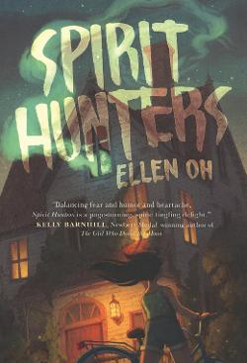
Spirit Hunters
Ellen Oh
"Harper doesn't trust her new home from the moment she steps inside, and the rumors are that the Raine family's new house is haunted. Harper isn't sure she believes those rumors, until her younger brother, Michael, starts acting strangely. The whole atmosphere gives Harper a sense of deja vu, but she can't remember why. She knows that the memories she's blocking will help make sense of her brother's behavior and the strange and threatening sensations she feels in this house, but will she be able to put the pieces together in time?"--

Slide 17

Stef Soto, Taco Queen
Jennifer Torres
Estefania "Stef" Soto is itching to shake off the onion-and-cilantro embrace of Tia Perla, her family's taco truck. She wants nothing more than for Papi to get a normal job and for Tia Perla to be a distant memory. Then maybe everyone at school will stop seeing her as the Taco Queen. But when her family's livelihood is threatened, and it looks like her wish will finally come true, Stef surprises everyone (including herself) by becoming the truck's unlikely champion. In this fun and heartfelt novel, Stef will discover what matters most and ultimately embrace an identity that even includes old Tia Perla.

Slide 18

Super Max and the Mystery of Thornwood’s Revenge
Susan Vaught
Twelve-year-old Max is determined to investigate the connection between a hacker's online attacks of her grandfather and other town officials and suspicious activity at the supposedly haunted Thornwood Manor, even though her grandfather, who is Blue Creek's police chief, wants to keep Max and her souped-up wheelchair out of police business.

Slide 19

The Van Gogh Deception
Deron Hicks
When a young boy is discovered in Washington, DC's National Gallery of Art without any recollection of who he is, he must piece together the disjointed clues of his origins while using his limited knowledge to stop one of the greatest art frauds ever attempted.

Slide 20
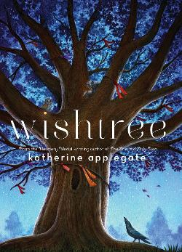
Wishtree
Katherine Applegate
Red is an oak tree who is many rings old. Red is the neighborhood "wishtree" ― people write their wishes on pieces of cloth and tie them to Red's branches. Along with her crow friend Bongo and other animals who seek refuge in Red's hollows, this "wishtree" watches over the neighborhood. You might say Red has seen it all. Until a new family moves in. Not everyone is welcoming, and Red's experiences as a wishtree are more important than ever.

Slide 21

You Go First
Erin Entrada Kelly
Twelve-year-old Charlotte Lockard and eleven-year-old Ben Boxer are separated by more than a thousand miles. On the surface, their lives seem vastly different--Charlotte lives near Philadelphia, Pennsylvania, while Ben is in the small town of Lanester, Louisiana. Charlotte wants to be a geologist and keeps a rock collection in her room. Ben is obsessed with Harry Potter, presidential history, and recycling. But the two have more in common than they think. They're both highly gifted. They're both experiencing family turmoil. And they both sit alone at lunch.
Over the course of a week, Charlotte and Ben--online friends connected only by a Scrabble game--will intersect in unexpected ways, as they struggle to navigate the turmoil of middle school.

Slide 22
Credits
Summaries provided by Follett Titlewave.

