Slide 1

2018 - 19
South Carolina
CBA
Nominees

Slide 2

Allie, First at Last
by Angela Cervantes
Allie Velasco is the least awarded person in her family. She is an obsessed fifth grader determined to win first place…at anything. Every member of her family is known for something. Allie tries and tries and it’s through failure that she learns that winning isn’t everything it’s cracked up to be. She learns valuable lessons in empathy and friendship.
Realistic

Slide 3

As Brave as You
by Jason Reynolds
Spending part of his summer away from Brooklyn scooping poop at his grandparent’s house isn’t eleven-year-old Genie’s idea of a good time. His parents send him and his big brother Ernie to Virginia for a month. Once in Virginia the boys have to deal with a long list of chores every day and a Grandpop who is blind and maybe crazy. Grandpop never goes outside, locks himself in a room filled with birds, and has a crazy idea about how to celebrate Ernie’s birthday – at least it’s crazy to Ernie, who wants no part of it. Genie doesn’t think it’s crazy at all. He thinks Ernie isn’t brave enough. But what does it really mean to be brave?
Realistic

Slide 4

Full of Beans
by Jennifer L. Holm
In depression era Key West, Beans Curry lives a hard-scrabble life, collecting cans to make pocket money and running the streets making mischief with his friends. When a New Deal government representative arrives and announces big plans to turn Key West into a tourist destination, Beans intends to cash in.
Historical

Slide 5
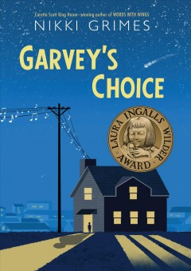
Garvey’s Choice
by Nikki Grimes
Garvey is interested in astronomy, science fiction and reading. His father has always wanted him to be athletic. Garvey, not being able to live up to his father’s expectations, comforts himself with food and his weight suffers. Though he is kind, smart and funny he is the target for bullies and often feels alone. Garvey’s life changes when he joins the chorus. He begins to accept himself, and becomes hopeful that he can reach his father through music.
Verse

Slide 6

Ghosts
by Raina Telgemeier
Catrina and her family are moving to the coast of Northern California because her little sister, Maya, is sick. Cat isn't happy about leaving her friends for Bahía de la Luna, but Maya has cystic fibrosis and will benefit from the cool, salty air that blows in from the sea. As the girls explore their new home, a neighbor lets them in on a secret: There are ghosts in Bahía de la Luna. Maya is determined to meet one, but Cat wants nothing to do with them. As the time of year when ghosts reunite with their loved ones approaches, Cat must figure out how to put aside her fears for her sister's sake - and her own.
Graphic Novel

Slide 7

Hamstersaurus Rex
by Tom O’Donnell
He disappeared just seconds after Sam named him Hamstersaurus Rex. Okay, well Dylan suggested the name to the class, but Sam thought it up. Such was Sam’s life in 6th grade. Trying to keep a low profile from the class bully didn’t always work out, especially while you are hunting down a missing hamster. Things wouldn’t have been too bad except the hamster mutated. Mutated, as in grew scary and growled and crazed over junk food. Even though Sam found Hammie, he decided to hide him and lie to his friends. Sam tells his side of the story in his crazy adventures with Hamstersaurus Rex in the humorous science fiction tale.
Science Fiction *Now a series*

Slide 8
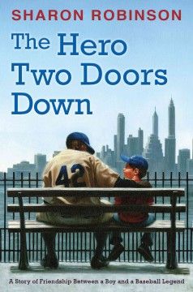
The Hero Two Doors Down : a Story of Friendship Between a Boy and a Baseball Legend by Sharon Robinson
Stephen Satlow lives in Brooklyn, New York and loves the Dodgers. He enjoys spending time with his dad talking about the Dodgers and listening to the games on the radio. He is a normal eight year old who deals with teacher challenges and changes in the neighborhood. When an African American family is rumored to be moving into his Jewish neighborhood, he dreams about Jackie Robinson being the one to move in. Stephen cannot believe his dream is coming true when he finds out that Jackie Robinson’s family is moving in down the street from him.
Historical

Slide 9
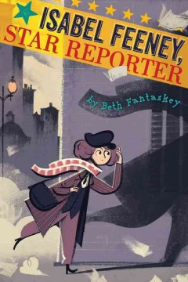
Isabel Feeney, Star Reporter
by Beth Fantaskey
Life in 1920’s Chicago was gangster tough. Even the gangsters died. As a newsgirl, Isabel Feeney, gets a first look at the news every day but wishes she was a crime reporter. On a fluke, Isabel miraculously arrives first at the murder scene of a famous mobster and decides she will be the one to solve the crime. Everyone is against her; the police, other reporters, and other gangsters. Isabel follows the clues, questions the facts and puts her life in danger. Will Isabel be able to solve the murder and get the adults to listen or will she become another victim of the Chicago violence?
Mystery

Slide 10

Like Magic
by Elaine Vickers
“For three ten-year-old girls, their once simple worlds are starting to feel too big. Painfully shy Grace dreads starting fifth grade now that her best friend has moved away. Jada hopes she’ll stop feeling so alone if she finds the mother who left years ago. And Malia fears the arrival of her new baby sister will forever change the family she loves. When the girls each find a mysterious treasure box in their library and begin to fill the box with their own precious things, they start to feel less alone. But it’s up to Grace, Jada, and Malia to take the treasures and turn them into something more: true friendship.” (from the publisher)
Realistic

Slide 11
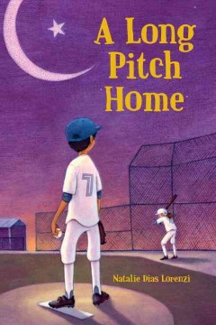
A Long Pitch Home
by Natalie Dias Lorenzi
Just before Bilal turns ten, his father disappears for three days. When he returns, Bilal’s life is uprooted when his family suddenly moves to live with relatives in Virginia, leaving his father behind. Over the course of the next year, Bilal discovers that his father has been falsely accused of a crime and must stay in Pakistan until he can clear his name, while the rest of the family starts over in a new country. Bilal must learn a new language, a new culture and a new sport. At home, he’s a great student and a cricket star, but in the US, he’s in remedial classes and, even worse, no one has even heard of cricket. He starts baseball camp and even though he’s the worst player on the team, Bilal finds a friend who understands how much he misses his father and he may also even discover a way to set his father free.
Realistic

Slide 12
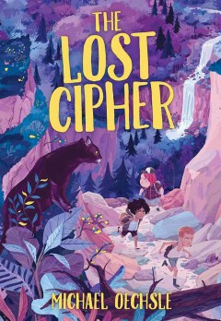
The Lost Cipher
by Michael Oechsle
Lucas Whitlatch’s summer is going to be very different. He’s being sent to Camp Kawani, a camp especially for kids who have lost a parent, and Lucas has lost both. It’s while he’s at camp, however, that he learns of a treasure that could change everything.
Adventure, *Real Cipher Included*

Slide 13

Moo
by Sharon Creech
Life goes from bad to worse for 12 year old Reena and her little brother Luke after their parents decide to move from the big city to Maine forcing them to leave everything familiar behind. One of the first people they meet is an old lady who is mean to them and makes Luke cry. If that isn’t bad enough, their parents loan them out to help on her farm. Told in verse this story will charm the most die-hard city slicker.
Verse

Slide 14

Pax
by Sara Pennypacker
Pax and Peter have been inseparable ever since Peter rescued him as a kit. But one day, the unimaginable happens: Peter's dad enlists in the military and makes him return the fox to the wild. At his grandfather's house, three hundred miles away from home, Peter knows he isn't where he should be—with Pax. He strikes out on his own despite the encroaching war, spurred by love, loyalty, and grief, to be reunited with his fox. Meanwhile Pax, steadfastly waiting for his boy, embarks on adventures and discoveries of his own.
Dystopian

Slide 15
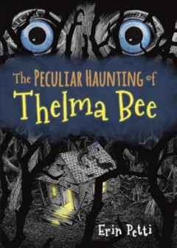
The Peculiar Haunting of Thelma Bee
by Erin Petti
Thelma Bee is not a typical eleven-year-old girl; she loves science. So when her father disappears into a magic world via an ancient box, Thelma has to learn to function in a mythical world with witches, ghosts and her own developing supernatural powers. Thelma begins to understand her family has been haunted for generations and she has the power to fight the evil forces trapping her father. The suspense is palpable as she confronts the demon Zachariah Understone to free her father. She may succeed, but at what cost.
Spooky

Slide 16
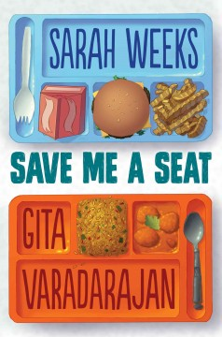
Save Me a Seat
by Sarah Weeks and Gita Varadarajan
Joe and Ravi seem to have nothing in common aside from being in the same fifth grade class. Joe has lived in New Jersey his whole life, while Ravi just moved to the United States from India. Over the course of the first week of fifth grade, both boys come to find they have more in common than they thought. Chapters alternate between Ravi and Joe’s perspective as the events of the week unfold.
Realistic

Slide 17

Slacker
by Gordon Korman
Video game obsessed eighth grader Cameron Boxer spends every waking moment playing video games and dreaming of showing off his skills as a video game champion. However, his focus on his video game causes a near disaster when he almost lets the house burn down around him. When his parents try to make him have more balance in his life, he creates a fake community service club to get them off his back but has no idea what the impact will actually be.
Realistic

Slide 18
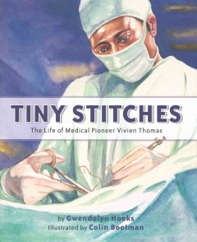
Tiny Stitches : The Life of Medical Pioneer Vivien Thomas
by Gwendolyn Hooks
Vivien Thomas's greatest dream was to attend college to study medicine. But after the stock market crashed in 1929, Vivien lost all his savings. Then he heard about a job opening at the Vanderbilt University medical school under the supervision of Dr. Alfred Blalock. Vivien knew that the all-white school would never admit him as a student, but he hoped working there meant he was getting closer to his dream. Overcoming racism and resistance from his colleagues, Vivien ushered in a new era of medicine children’s heart surgery. Tiny Stitches is the compelling story of this incredible pioneer in medicine.
Biography

Slide 19
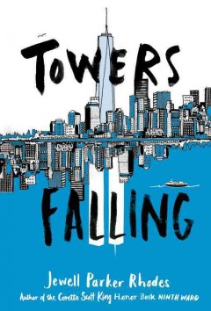
Towers Falling
by Jewell Parker Rhodes
When her fifth-grade teacher hints that a series of lessons about home and community will culminate with one big answer about two tall towers once visible outside their classroom window, Dèja can't help but feel confused. She sets off on a journey of discovery, with new friends Ben and Sabeen by her side. But just as she gets closer to answering big questions about who she is, what America means, and how communities can grow (and heal), she uncovers new questions, too. Like, why does Pop get so angry when she brings up anything about the towers?
Realistic

Slide 20

Weekends with Max and his Dad
by Linda Urban
Max and his dad love their weekends together. Weekends mean pancakes, pizza, spy games, dog-walking, school projects, and surprising neighbors! Every weekend presents a small adventure as Max gets to know his dad's new neighborhood – and learns some new ways of thinking about home. Acclaimed author Linda Urban deftly portrays a third-grader's inner world during a time of transition in this sweet and funny illustrated story that bridges the early reader and middle grade novel.
Realistic

Slide 21

Welcome to Wonderland : Home Sweet Motel
by Chris Grabenstein
P.T. Wilkie’s life has never been boring. His home is the Wonderland Motel and life couldn’t be sweeter...except for one little problem. There are no customers at his family owned motel and if they can’t come up with the money soon, they may have to say goodbye.
Humor

Slide 22
2018-19 SC Children’s
Book Award Nominees

